Slide 1
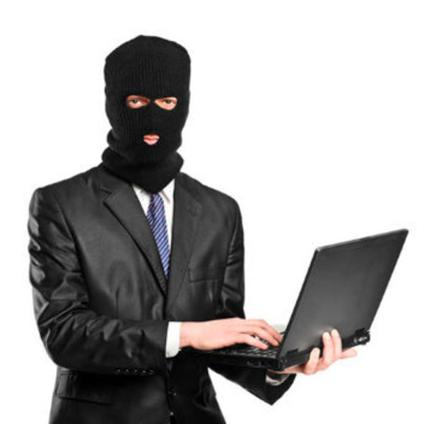
Do convicted hackers still have the right to internet access?
CIS 481-50
Jackson Dillingham, Matt Jackson, Hilton Siaffa, Tabor Payne, and Emily Wantland,

Slide 2
The internet plays a role in the greater majority of our everyday lives. People have the right to broadband or freedom to connect. Internet access must be broadly available, and access cannot be unreasonably denied. That said, those guilty of crimes involving the internet have had this access restricted.
Hackers, like any other convicted criminal, will have served their time and reached the point of rehabilitation. Should they be discriminated against? What are the criteria for a lifetime ban? What does a successful appeal look like? Who has the power to decide that someone doesn’t deserve this access anymore?

Slide 3

The UN declared that “online freedom” is a “human right” and that it must be protected.

Slide 4

The right to the internet was created in the form of resolution A/HRC/32/L.20.
Even though A/HRC/32/l.20 was passed, it is not enforceable because it is a “soft law” and not a “hard law”.

Slide 5
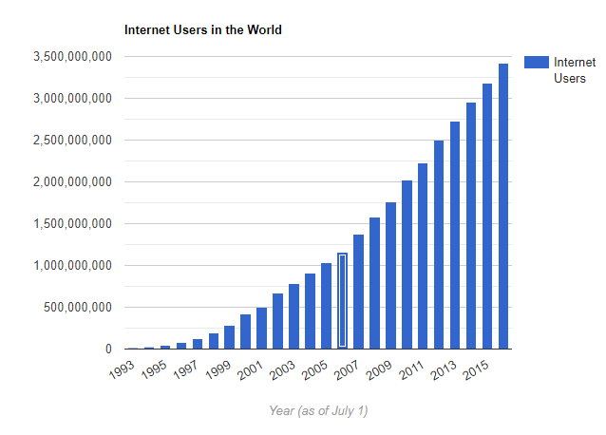

Within the last 30 years, internet usage has surged
There are a total of 4,602,115,350 people accessing the internet right now. Around 40% of the world population has accessed the internet today.

Slide 6
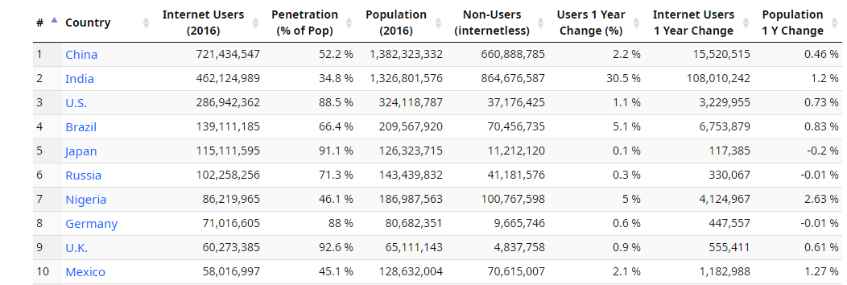
The internet gives us access to an infinite amount of information at the touch of a button. It has changed the way we receive information in drastic ways.

Slide 7
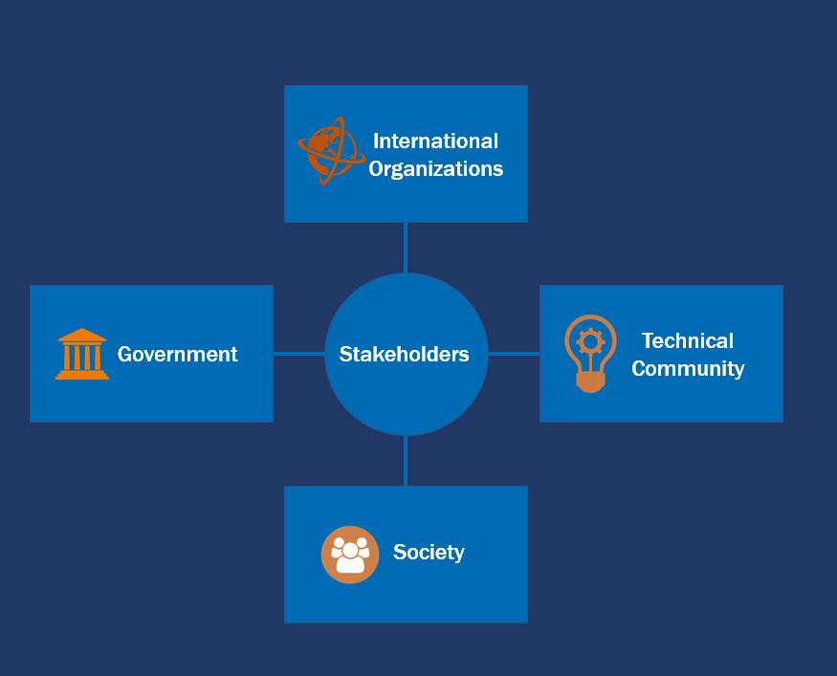
Four Main Stakeholders
The Government and Society go hand-in-hand with internet access. International organizations and the technical community rely on internet access.

Slide 8
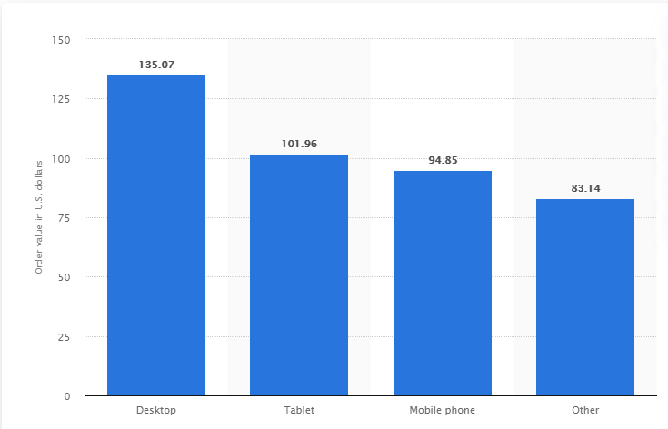
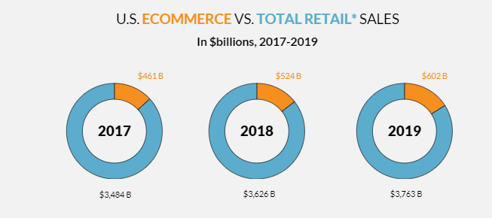
U.S. Online Shopping Order Value by Device 2019

Slide 9
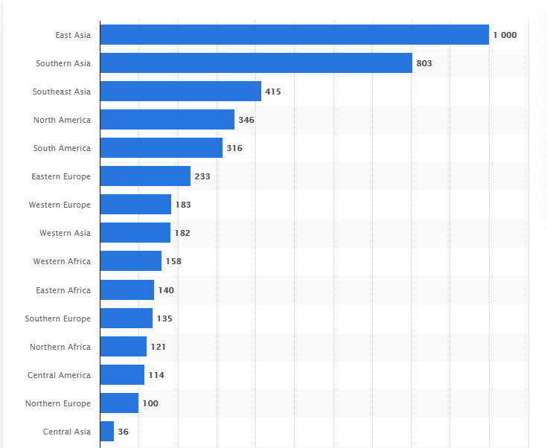
Number of Internet Users Worldwide as of January 2019

Slide 10

Who is Restricted from using the internet?
Although convicted hackers are felons in the eyes of the law, it is unnecessary to strip away their rights and access to the internet.

Slide 11
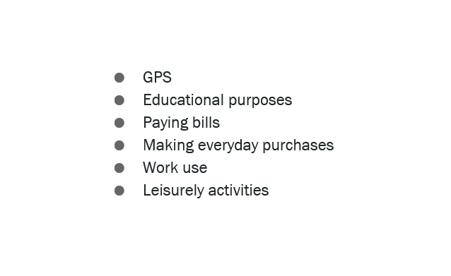
During this age people are dependent on their IOT devices, phones, and computers for a larger amount of things.

Slide 12
Higinio Ochoa - He was arrested and imprisoned for hacking police websites to expose officers engaged in police brutality. As punishment after serving his time in prison, he was ordered to live an internet free life. Even though he is content with the life he lives now, if he did not have a wife to help him, his living situation would not be realistic.
Kevin Mitnick - The world’s most famous hacker that was sentenced to an internet free life after going to prison; he could not work with computers or computer-related equipment or software. Mitnick could not attend school or even work at a fast food restaurant with computerized registers. But due to his abilities, he was able to defy the odds and create a living through this whole ordeal in which he is now a successful author and cyber speaker.
Deric Lostutter - His group exposed school football members. In the video that was shown to the public, you can see a young woman get physically assaulted by these members of the football team. The hacker was caught and sentenced five times longer than the depicted rapists.

Slide 13

Alternative Courses of Action
24/7 Online Monitorization
Access to approved devices
In-person monitoring by probation officers
Random Drop-by

Slide 14
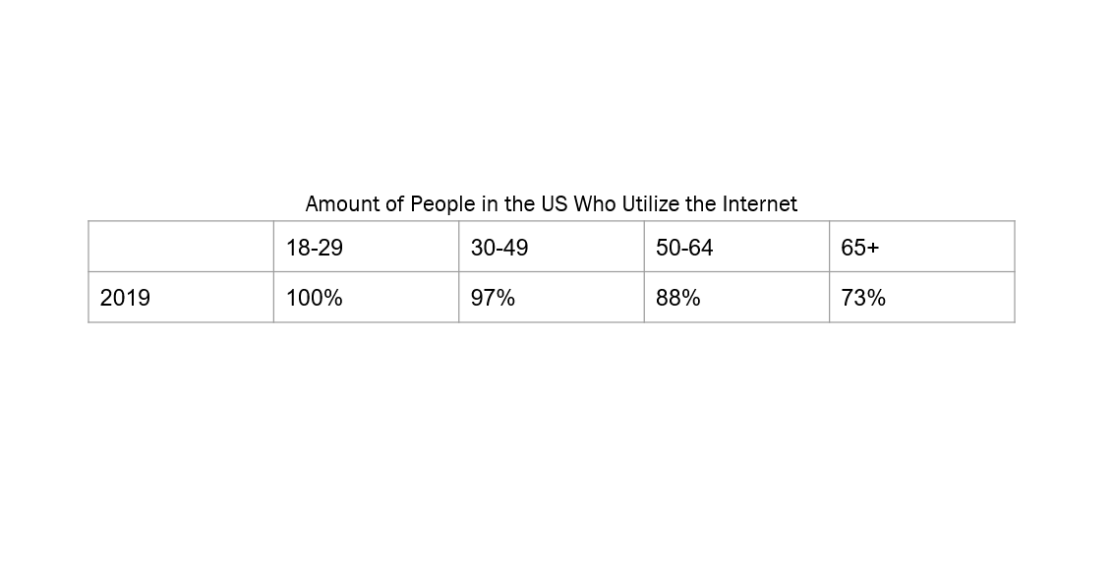
Supreme Court Case Packingham v. North Carolina
An outright ban on the internet is unlawful. The Internet is today’s public streets and parks. Lawful speech cannot be limited to prevent unlawful speech. It is a 1st amendment violation.

Slide 15
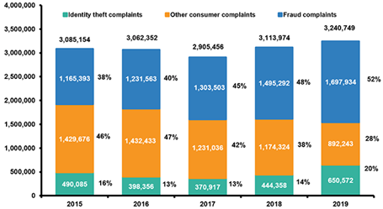
The Teleological perspective finds it ethical to ban convicted hackers from the internet
Through a Utilitarian POV
Government, Internet Users, Convicted Hackers

Slide 16
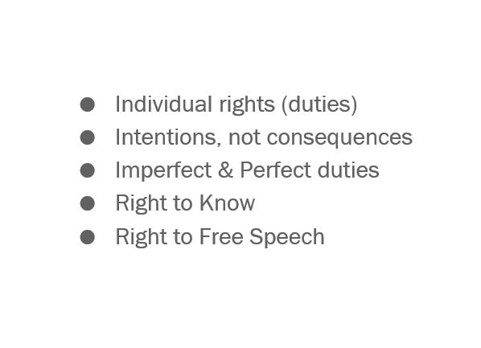
The Deontological perspective finds it unethical to ban convicted hackers from the internet.

Slide 17
Our normative recommendation is that those banned from using the internet appeal the decision. They should procure a legal defense to draft their appeal and begin litigation.
Societal stakeholders will benefit from successful cases as they can be used as references or create new policies and laws as seen in Packingham v. North Carolina.
Convicted criminals should not be banned from using the Internet.

Slide 18

Why was Higinio Ochoa sentenced to an Internet free life?
Who are the four major stakeholders of the Internet?
Through a deontological perspective, is it ethical to ban someone from the Internet?

